Slide 1

PROJECT TITLE
Diwali Sales Analysis
An In-depth Analysis of Sales Data During Diwali Season
Presented By
P Sujith
Batch no. : UPOPDM02

Slide 2
PROJECT SUMMARY
Objective: Analyze sales data from Diwali to gain insights into sales
Performance,customer behavior, and identify trends.
Purpose: Inform business decisions for future campaigns

Slide 3
Contents
Abstract
Problem Statements
Softwares used
Dataset
Exploratory Data Analysis
Conclusion

Slide 4
ABSTRACT
The Diwali Sales Analysis project leverages Python libraries (NumPy, Pandas, Matplotlib, Seaborn) to analyze sales data, uncovering insights into sales performance, customer behavior, and trends during the Diwali season. This analysis identifies top-selling products, profiles high-spending customers, and examines regional sales trends to inform data-driven business strategies for inventory management and marketing. The project aims to optimize future Diwali campaigns through efficient data handling and visualization.

Slide 5
PROBLEM STATEMENTS
Identify top-selling products during Diwali.
Profile the highest spending customers.
Analyze sales trends across different regions.
Identify and understand the impact of outliers.
Use data visualization to inform business strategies.

Slide 6
SYSTEM REQUIRMENTS
Google colab Notebook
Numpy
Python
Pandas
Matplotlib
Seaborn

Slide 7
NUMPY
Description: Fundamental package for scientific computing in Python.
Key Features:
N-dimensional arrays: Efficient storage and manipulation.
Mathematical functions: Arithmetic, trigonometry, statistics, linear algebra.
Broadcasting: Element-wise operations between different shaped arrays.

Slide 8
PANDAS
Description: Powerful library for data manipulation and analysis.
Key Features:
Data structures: Series and DataFrame for storing and manipulating data.
Data manipulation: Filtering, sorting, aggregating, and transforming data.
Integration: Seamlessly works with NumPy and Matplotlib.

Slide 9
MATPLOTLIB
Description: Widely used for static, interactive, and animated visualizations.
Key Features:
Plot customization: Control over colors, markers, labels, axes, grids, and annotations.
Multiple backends: Output to formats like PNG and PDF.

Slide 10
SEABORN
Description: High-level interface based on Matplotlib for statistical graphics.
Key Features:
Ease of use: Simplifies complex data visualization.
Statistical plotting: Effective for visualizing statistical relationships.
Themes and aesthetics: Built-in themes and color palettes.

Slide 11
DATA PREPARATION
Libraries: Pandas, NumPy, Matplotlib, Seaborn
Dataset Path: /content/Diwali Sales Data.csv
Variables:
User_ID
Cust_name
Product_ID
GenderAge
GroupAge
State
Zone
Occupation
Product_Category
Orders
Amount
Status
unnamed1
Marital_Status

Slide 12
Data Cleaning and Exploration
Missing Values: Check and handle missing data.
Duplicates: Identify and remove duplicates.
Unique Values: Analyze unique values for categorical variables.
Initial Analysis: Perform initial experiments and visualizations.

Slide 13
Outliers and Data Description
Statistical Summary: Describe dataset using summary statistics.
IQR Technique: Identify and remove outliers.
Clean Dataset: Ensure dataset is clean and ready for analysis.

Slide 14
Data Visualization
Sales by Product Category: Bar plot
Sales by Region: Bar plot
Customer Demographics: Count plot of Gender and Age Group

Slide 15
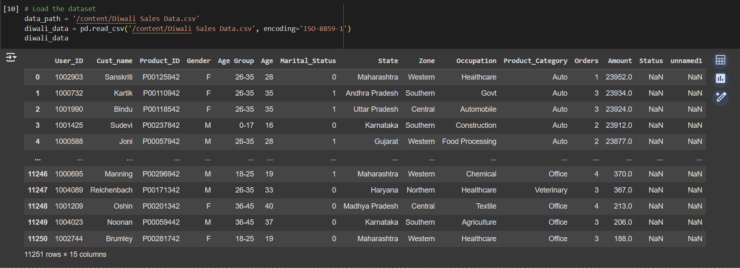
DATASET

Slide 16
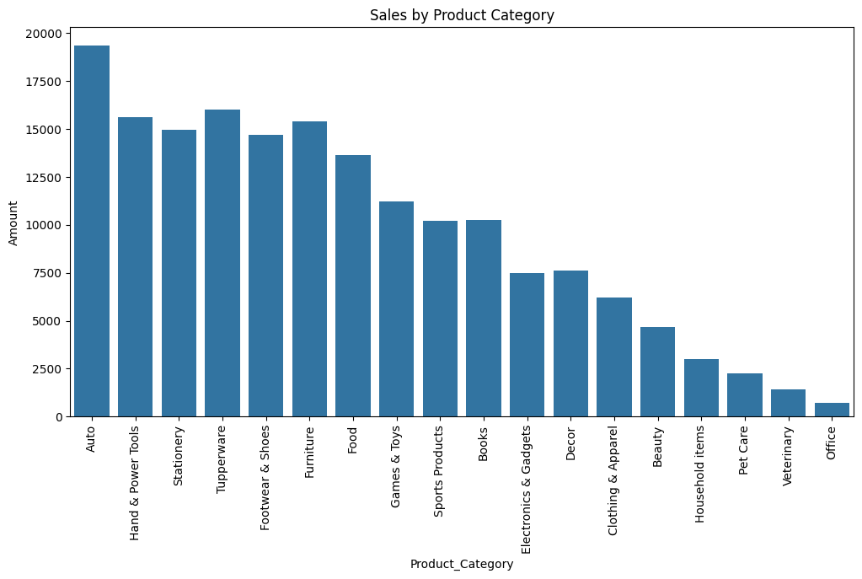
Exploratory Data Analysis

Slide 17
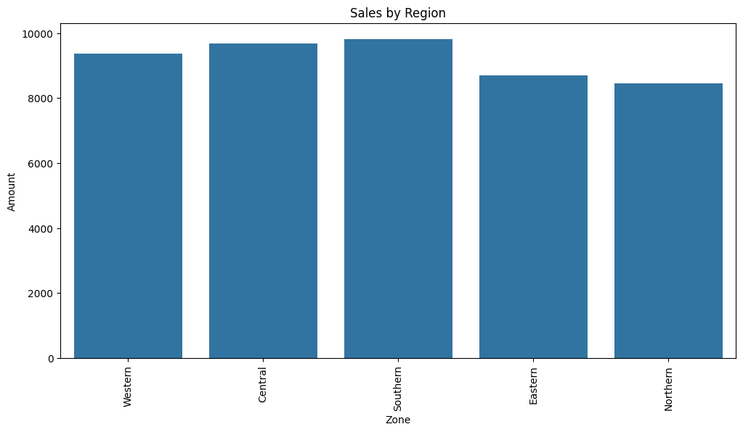

Slide 18
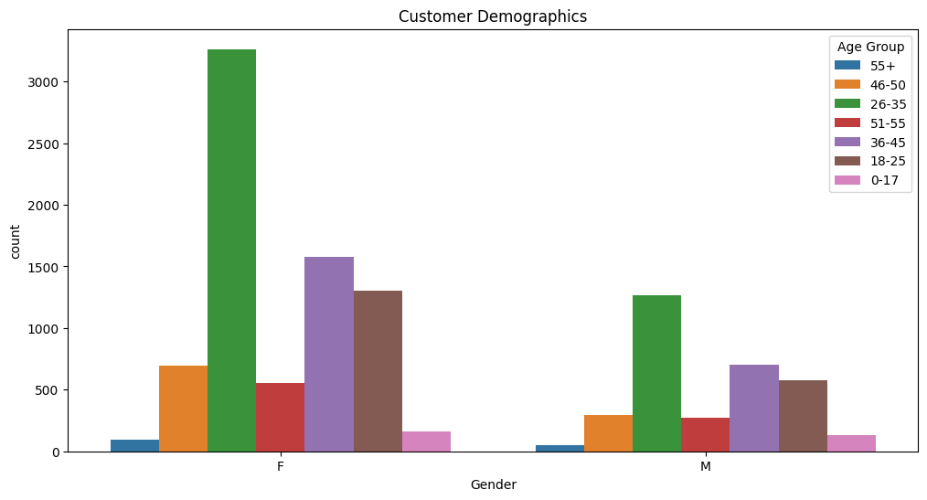

Slide 19
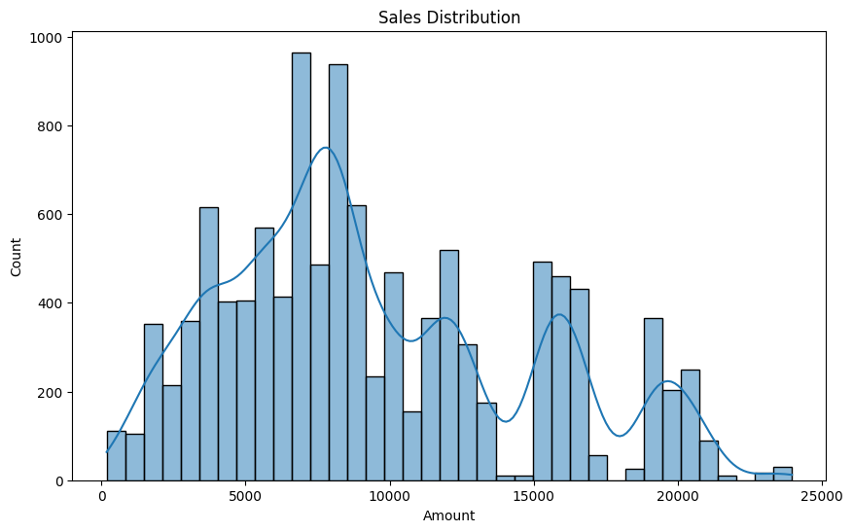

Slide 20
CONCLUSION
Product Performance: Ensure top-selling products are well-stocked for future Diwali seasons.
Customer Demographics: Target marketing campaigns towards high-spending demographic groups.
Regional Insights: Allocate more resources and marketing efforts to regions with higher sales.
Data-driven Decisions: Use insights to inform inventory management, marketing, and customer engagement strategies.

Slide 21
THANK YOU

